Slide 1
Control Flow
Principles of Programming Languages (CS213)
Prof. M. N. Sahoo
sahoom@nitrkl.ac.in
sahoo.manmath@gmail.com

Slide 2
Introduction
Control flow decides the order of statement execution in a program.
4 ways to control
Sequencing
Unconditional Jump/ Branch
Selection/ Alternation
Iteration/ Loop

Slide 3
Sequencing
Principal means of controlling the order in which side effects occur.
In most imperative programming languages, sequencing comes naturally.
But, few languages (e.g. LISP, Scheme) provide special constructs for sequencing.

Slide 4
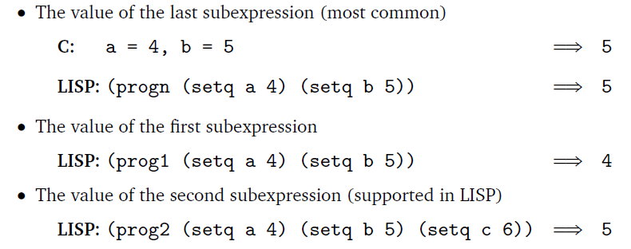
Sequencing issue : value of expression ?

Slide 5
goto and alternatives
In assembly language control flow is achieved using goto statements.
Early programming languages had adapted the unstructured goto control statement.
Lots of goto affects readability.
With the evolution of structured programming concept, structured control constructs were developed. e.g. for, if, switch etc.

Slide 6
Difference between return and goto ???
Sometimes, however, goto is unavoidable:
e.g. Break out of a deeply nested context
(the run-time stack of subroutine call is repaired and the operation is called unwinding)
GOTO simply jumps to another line,
GOSUB keeps track of where it came from (on a stack, presumably),so when the interpreter encounters a RETURN,
it goes back to the last place GOSUB was called.

Slide 7
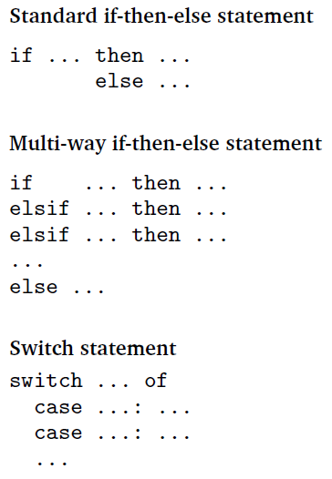
Selection

Slide 8
Short-Circuited conditions and Jump code
Boolean expression in selection statement is not computed to be stored in any register.
It simply causes control to branch to a particular location.
This can help in generating efficient code called jump code.

Slide 9
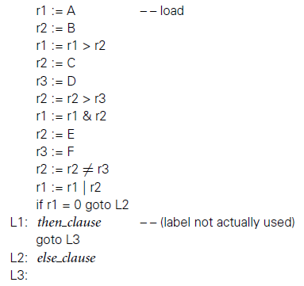

Pascal doesn’t use short-circuit evaluation

Slide 10
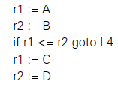
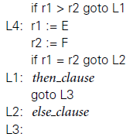
Corresponding jump code
Jump code is shorter and faster.
It does not store the result of the boolean expression.

Slide 11
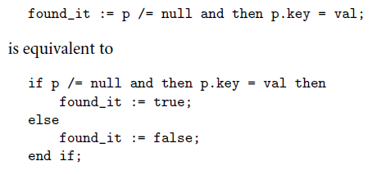
However, explicitly, the value of the boolean expression can be stored even in case of jump code.
Notes:
In Ada

Slide 12
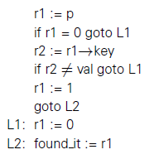
Translated to
There is a scope of code improvement. Where???

Slide 13
Switch Statements
Switch statements are a special case of if/then/elsif/else.
Principal motivation: Generate more efficient code.

Slide 14
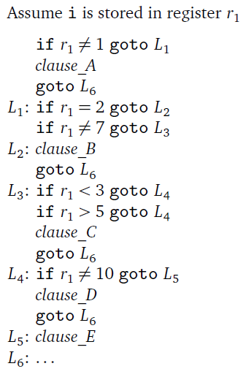
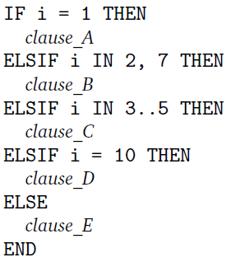
Implementation of Switch Statements(1)
Sequential tests for a series of possible values

Slide 15
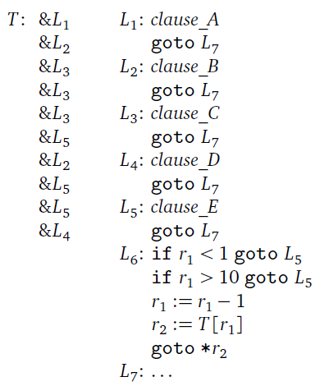
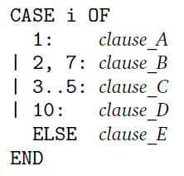
Implementation of Switch Statements(2)
Fetches the right jump address immediately
T: Jump Table
Notes:
Modula-2 CASE

Slide 16
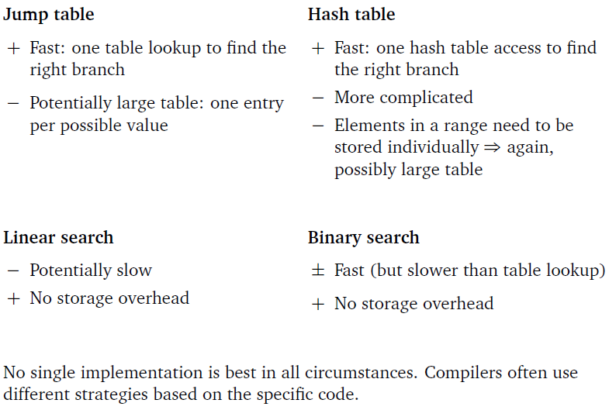
Implementation of Switch Statements(3)

Slide 17
Iteration
Enumeration-controlled loops
Example: for-loop in Modula-2 and Ada, do-loop in Fortran
One iteration per element in a finite set.
The number of iterations is known in advance.
Logically controlled loops
Example: while-loop
Executed until a Boolean condition changes.
The number of iterations is not known in advance.

Slide 18
Fortran
do i = 1, 10, 2
...
Enddo
Modula-2
FOR i := first TO last BY step DO
...
END

Slide 19
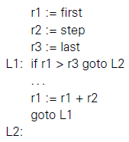
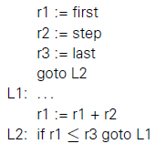
Code Generation for for Loops
26
(Target Code-2)
(Target Code-1)
Which Code is better???
If step < 0 then compiler generates different code with different test condition.
A good code may be translated to an infinite loop !!

Slide 20

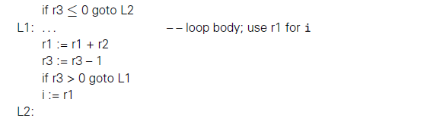
Generic translation
Pre-compute the number of iterations

Slide 21
Generic translation
Iteration count works well for +ve or –ve step.
It avoids the problem that a perfectly good source code may be translated into an infinite loop

Slide 22
However, if a loop body modifies the index and/or end-of-loop bound variable then, the no. of iterations can’t be pre-computed.

Slide 23
Issues
Can control enter or leave the loop in any way other than through the enumeration mechanism?
What happens if the loop body modifies variables that were used to compute the end-of-loop bound?
What happens if the loop body modifies the index variable itself?
Can the program read the index variable after the loop has completed, and if so, what will its value be?

Slide 24

Issue 1: break, exit; and goto;
Issue 2: some languages compute bound once and store it in temporary location
Issue 3:
After i=3, i can be 5, 8, or 7
Some languages don’t allow the modification of index variable inside body

Slide 25
Issue 4: if index variable declared inside the loop header then the issue don’t arise.
If declared outside then the value depends on the type of exit
Exit through break or exit() call → value of current iteration.
Normal exit→next value after the bound
But, if next value exceeds the boundary of the range??

Slide 26
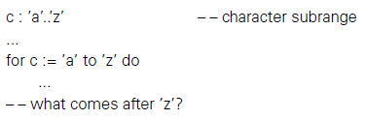
Can target-code 1 or 2 in slide 19 be used for the above for loop???

Slide 27
Solution to issue 3 & 4 in Algol, Ada, Modula-3
Loop header declares the index
The type of the index is inferred from the bounds of the loop

Slide 28
Logically Controlled Loops
Pre-loop test
while ... do ...
Post-loop test
repeat ... until ...
do ... while ...
Loop is executed at least once.
Mid-loop test or “one-and-a-half loop”
loop
...
when ... exit
...
when ... exit
...
end

Slide 29
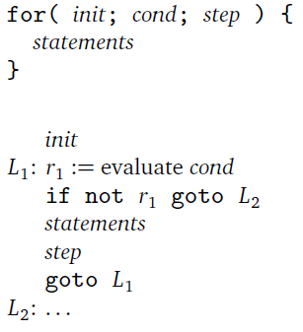
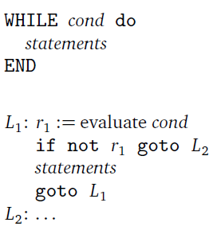
Trade-Offs in Iteration Constructs
Logically controlled loops are very flexible but enumeration controlled loops are faster.

Slide 30
Recursion
Every iterative procedure can be turned into a recursive one:
while(condition){ S1; S2; ...} becomes
procedure P() {
if( condition ) {
S1; S2; ...; P();
}
}
The converse is not true (e.g., quicksort, merge sort, fast matrix multiplication,. . . )

Slide 31
Why don’t functional languages support iteration?
because, Iteration is a strictly imperative feature: it relies on updating the iterator variable.

Slide 32
Implementation of Recursion
* A naive (easy ) implementation of recursion is often less efficient than a naive implementation of iteration.
An optimizing compiler often converts recursion into iteration when possible.

Slide 33


Tail recursion: There is no work to be done after the recursive call. (Standard method for implementing iteration in functional languages)
(Scheme Code)

Slide 34

Tail-Recursive form

Slide 35
Applicative and Normal Order of Evaluation
Applicative-order evaluation
Arguments are evaluated before a subroutine call.
Default in most programming languages.
Normal-order evaluation
Arguments are passed unevaluated to the subroutine. The subroutine evaluates them as needed.
Useful in case of short-circuit evaluation.
Useful in handling infinite sequence

Slide 36

Lazy Evaluation in Scheme
By default, Scheme uses strict evaluation.
This code runs forever

Slide 37
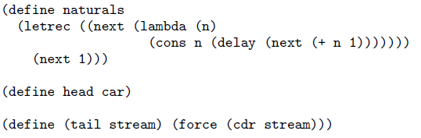
Lazy Evaluation in Scheme

Slide 38
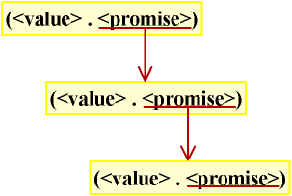
Lazy Evaluation in Scheme
car→value cdr→promise
Promise means the evaluation has not yet been done
“delay” specifies that it is a promise
Final evaluation is done by applying “force” to promise
(Structure of infinite sequence in Scheme using lazy evaluation)

Slide 39


